Slide 1



Automatyzacja za pomocą Azure DevOps
Piotr Rogala

Slide 2

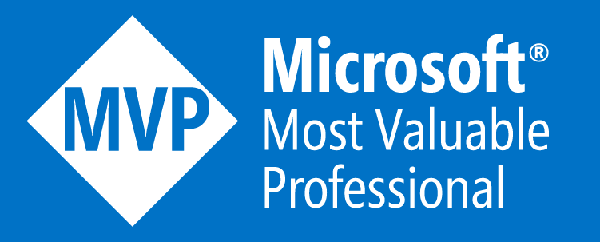

About Me
MVP Azure
Blog: justcloud.pl
FB Page: facebook.com/justcloudpl
Group leader:
Microsoft Azure User Group Poland

Slide 3
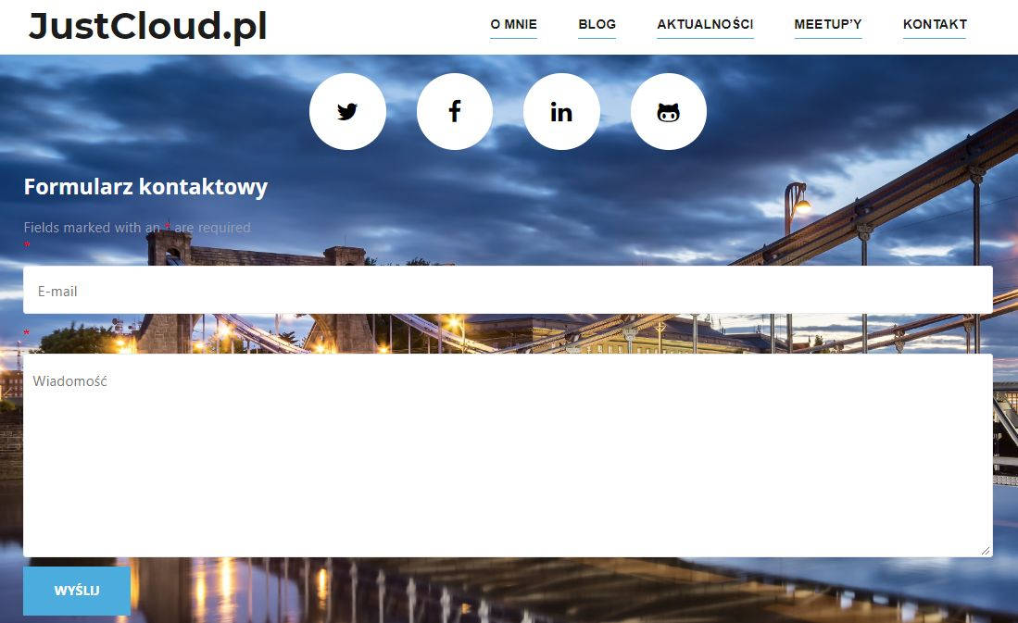
Questions?

Slide 4


CloudPoland
http://slack.justcloud.pl
MAUGP
http://azureug.org

Slide 5
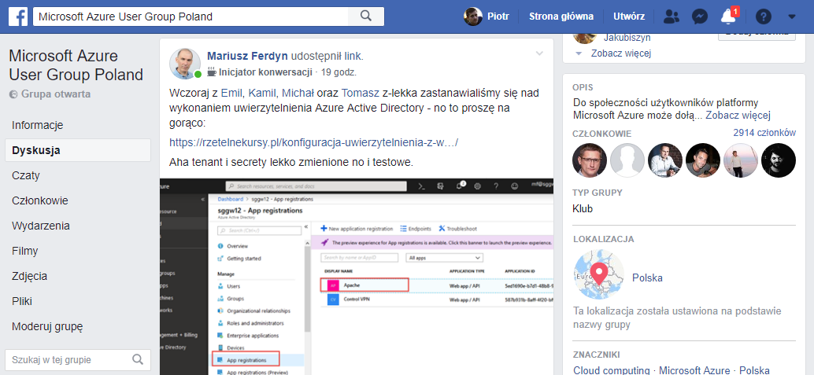

Grupa Microsoft Azure User Group Poland
https://www.facebook.com/groups/azureugpl

Slide 6
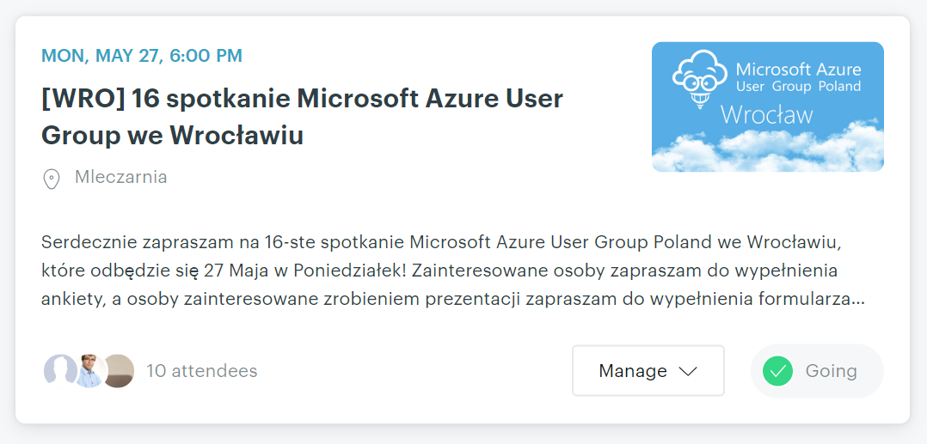
https://www.meetup.com/Microsoft-Azure-Users-Group-Poland

Slide 7
topic: Automatyzacja za pomocą Azure DevOps

Slide 8
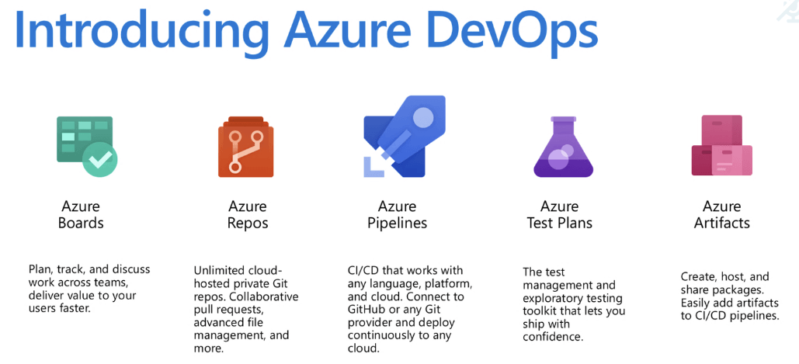

Slide 10
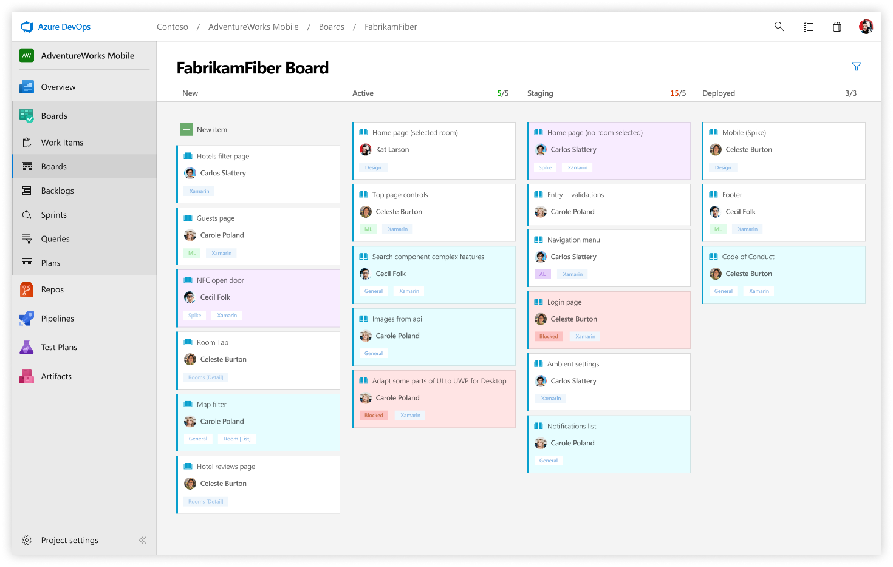

Slide 11
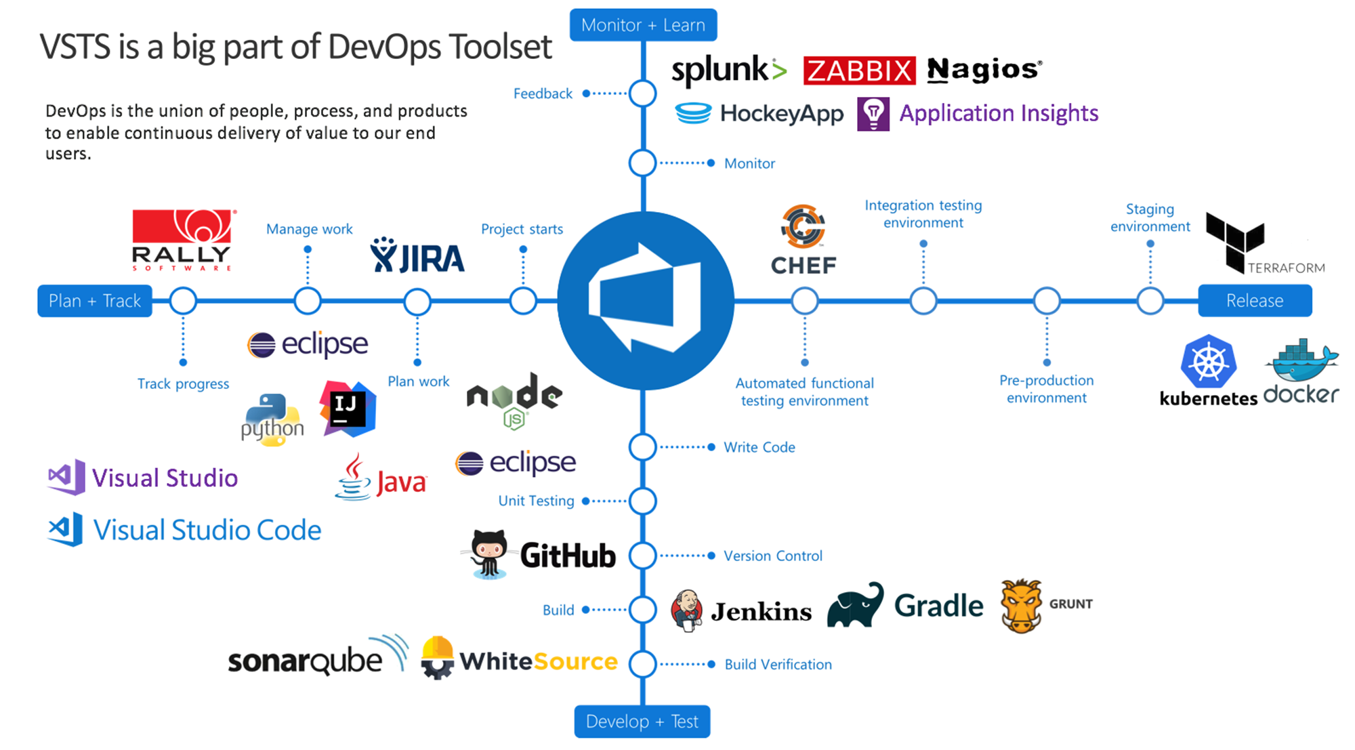

Slide 12
What is DevOps?
People. Process. Products.
Build& Test
Deploy
DevOps is the union of people, process, and products to enable continuous delivery of value to your end users.
“
Continuous Delivery
Develop
Operate
”
Plan & Track
Monitor & Learn

Slide 13
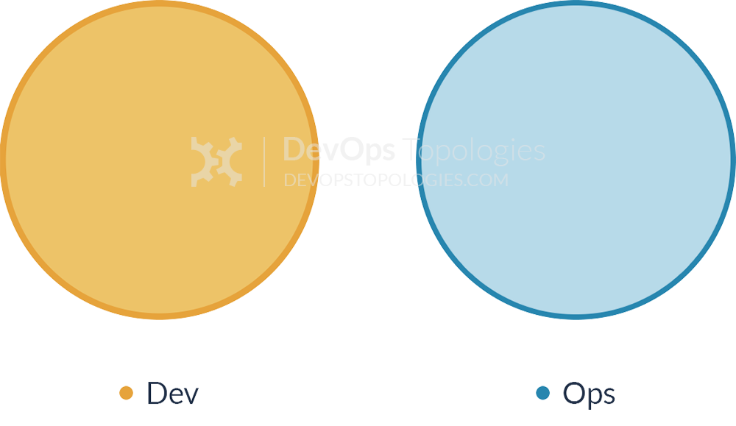
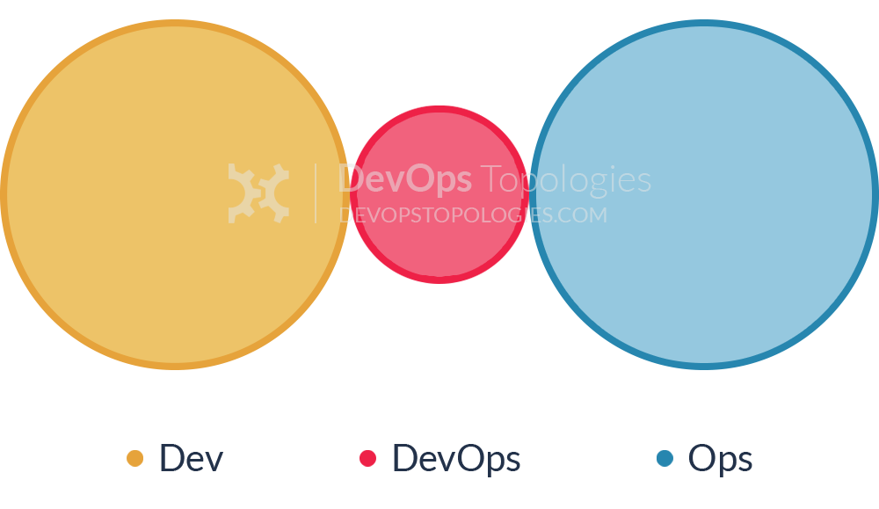
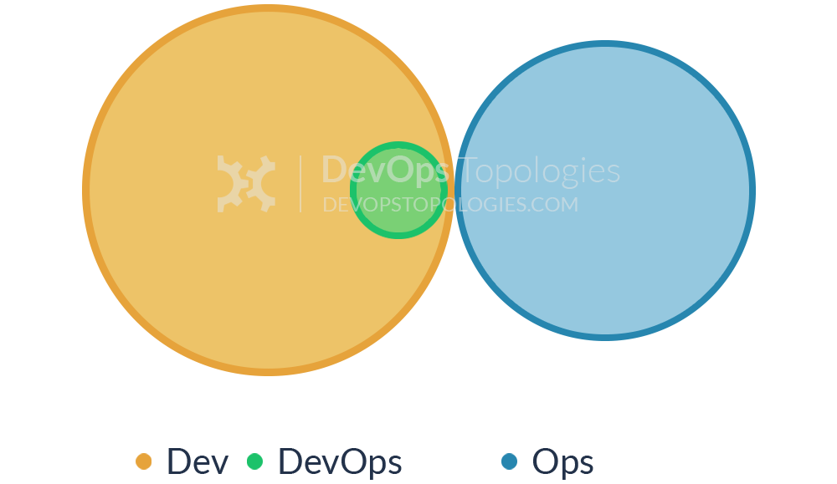
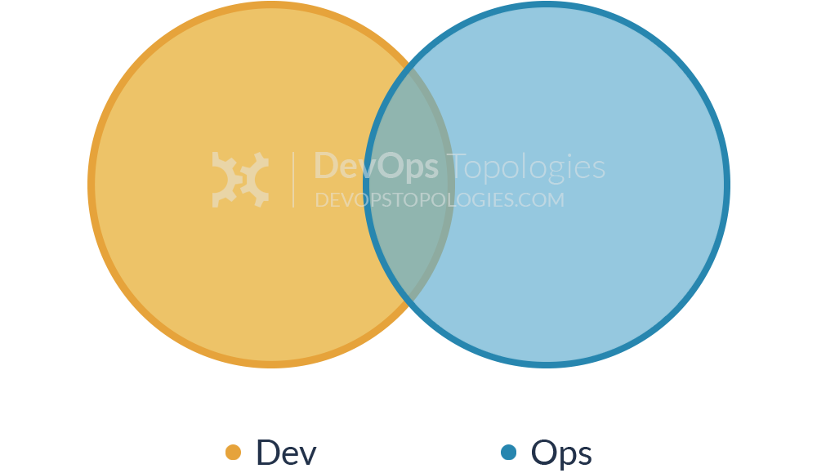
Anti-Type
Anti-Type
Potential effectiveness: HIGH
Potential effectiveness: MEDIUM

Slide 14
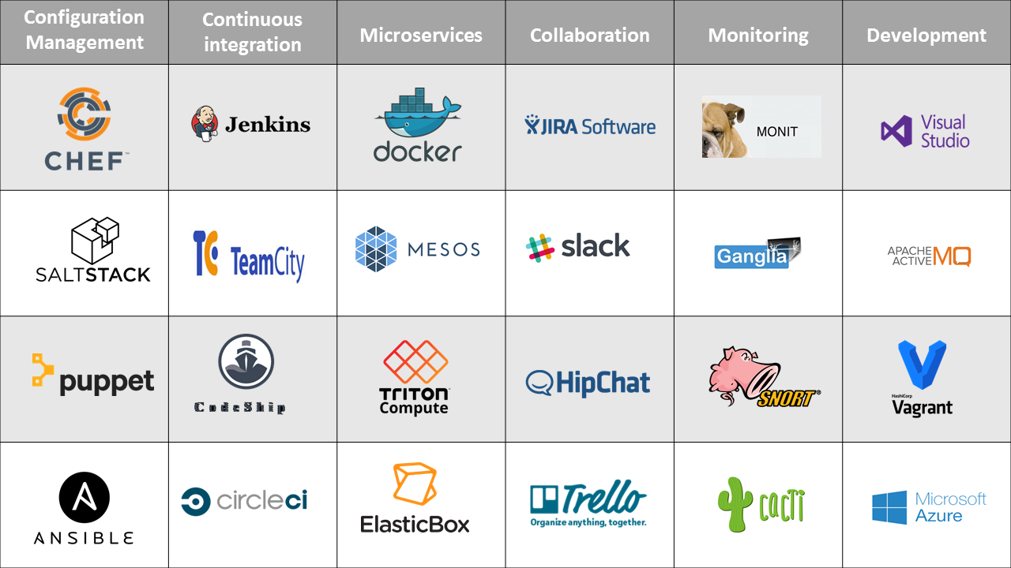

Slide 15
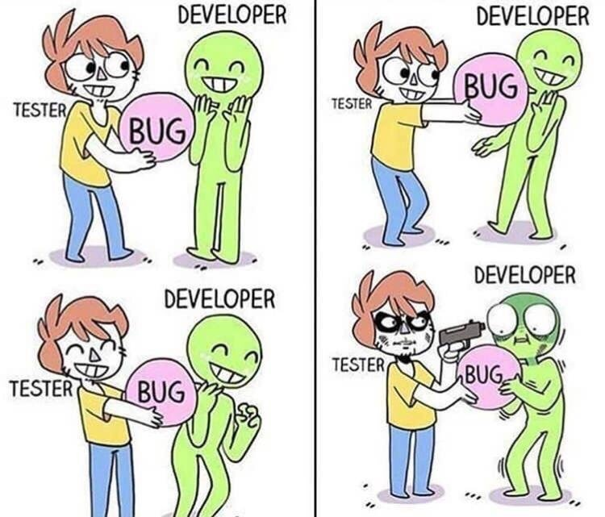

Slide 16
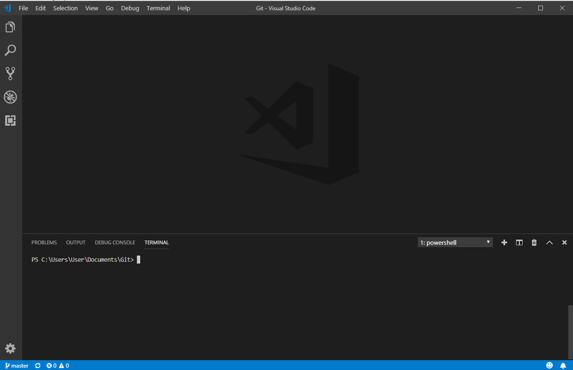

Slide 17
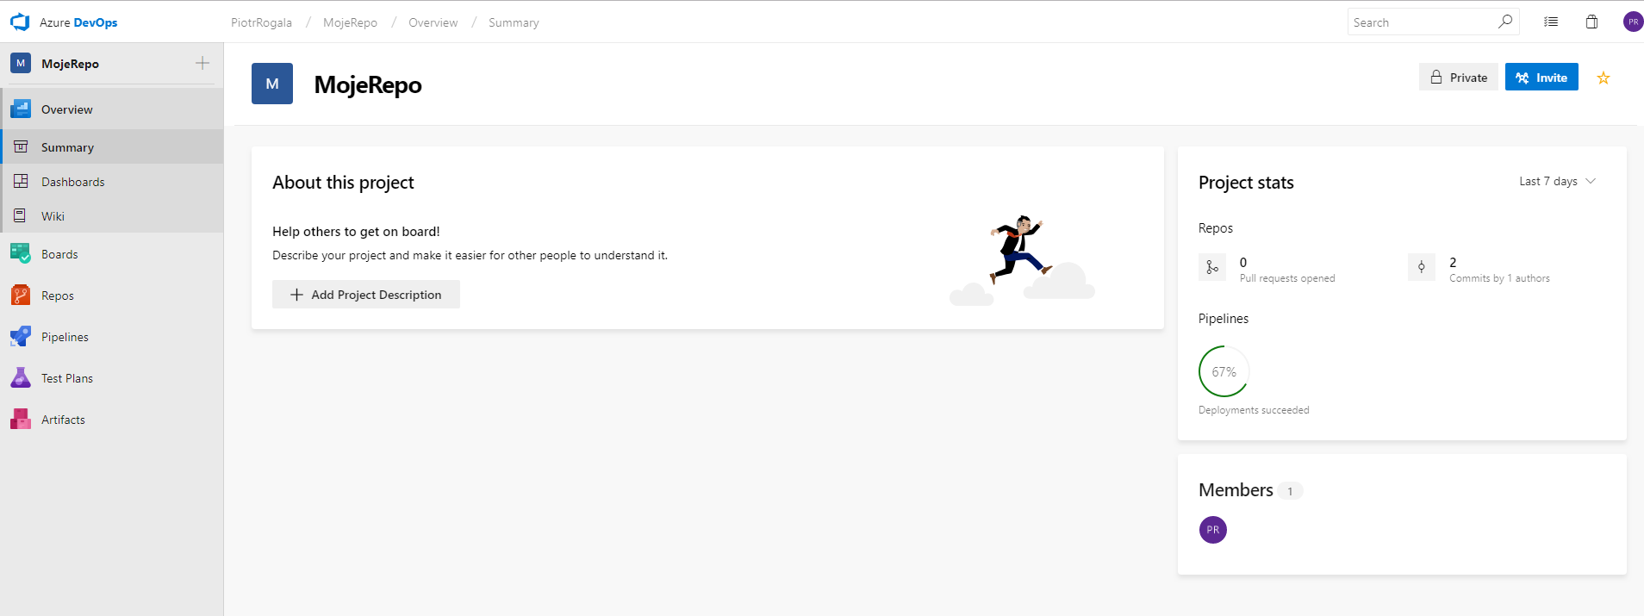

Slide 18
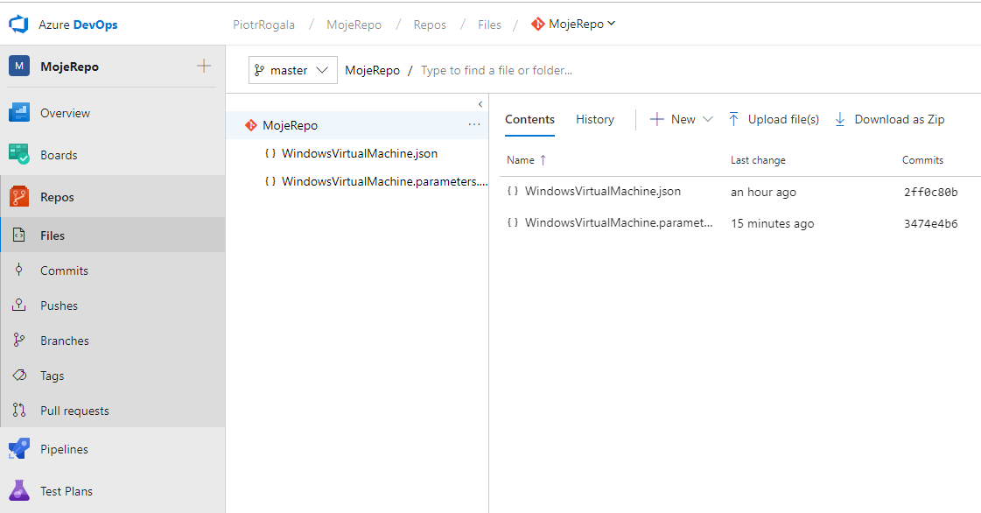

Slide 19
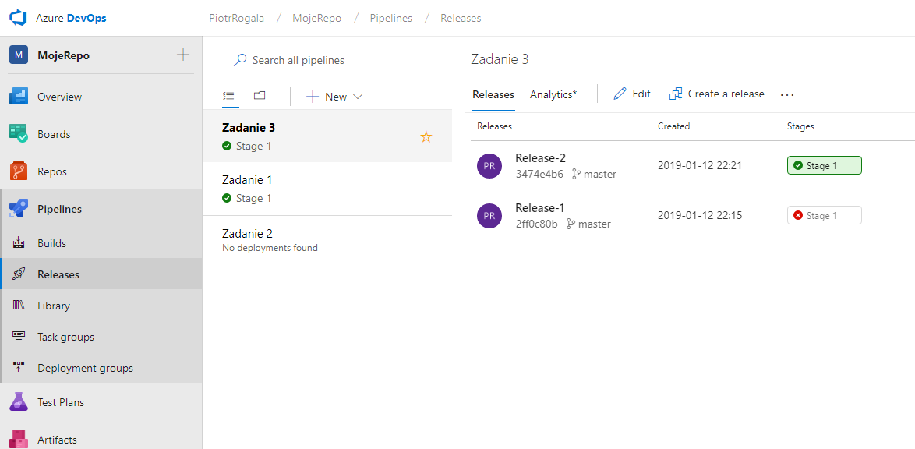

Slide 20




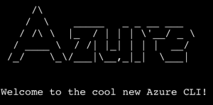
Azure Manage
Portal WEB
Visual Studio
Visual Studio Code
Azure DevOps (VSTS)
PowerShell
CLI (cross-platform)

Slide 21


Slide 22
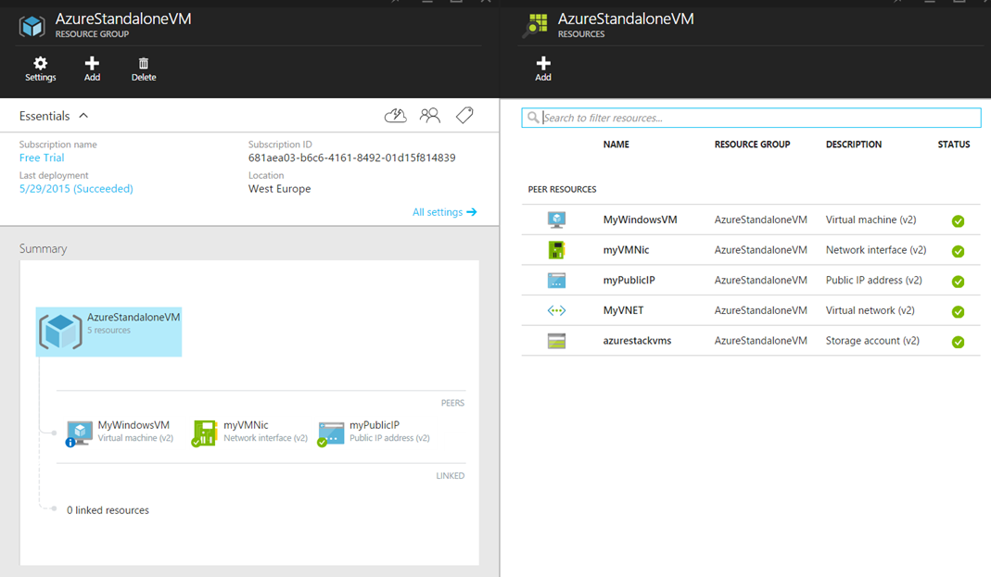
Azure Resource Group

Slide 23
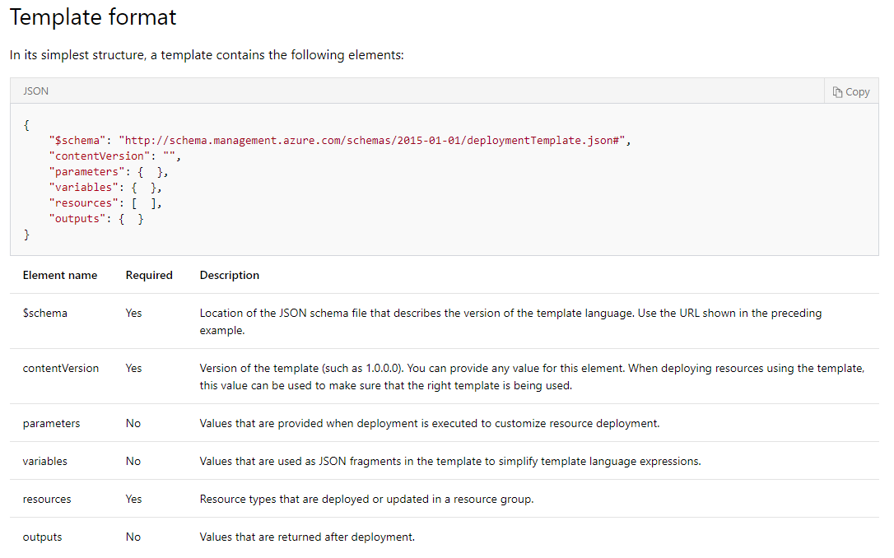
https://docs.microsoft.com/en-us/azure/azure-resource-manager/resource-group-authoring-templates

Slide 24
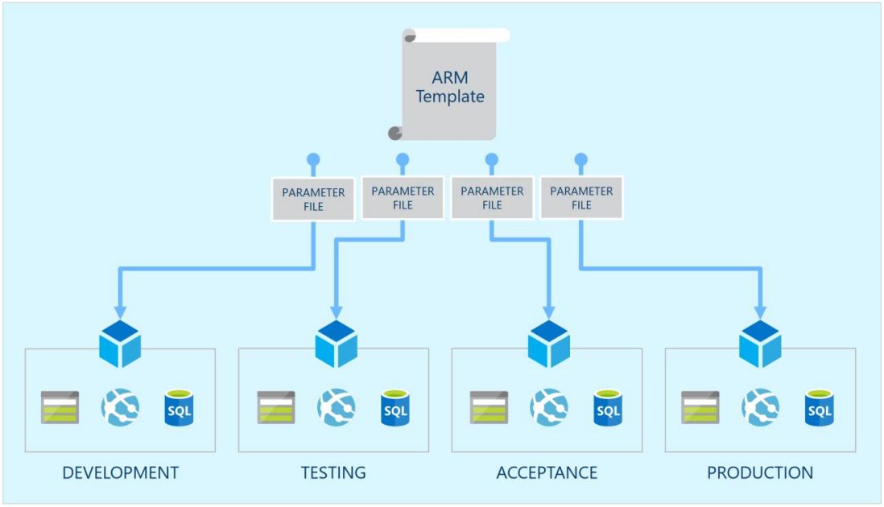

Slide 25
Gotowe szablony - .json
https://github.com/Azure/azure-quickstart-templates
https://github.com/RogalaPiotr/JustCloudPublic

Slide 26
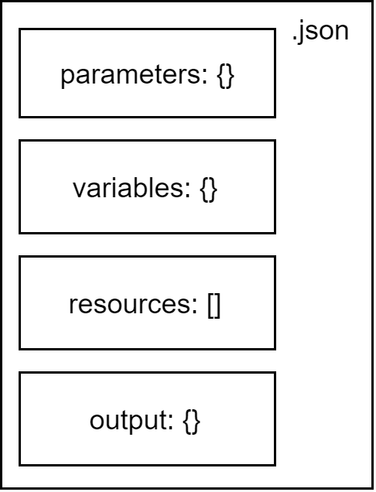

Slide 27
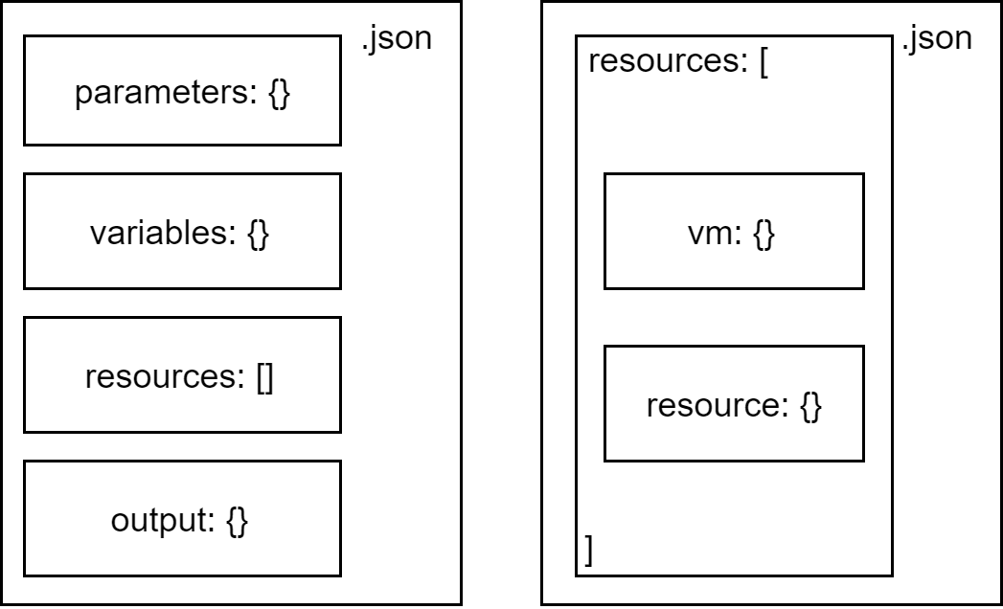

Slide 28
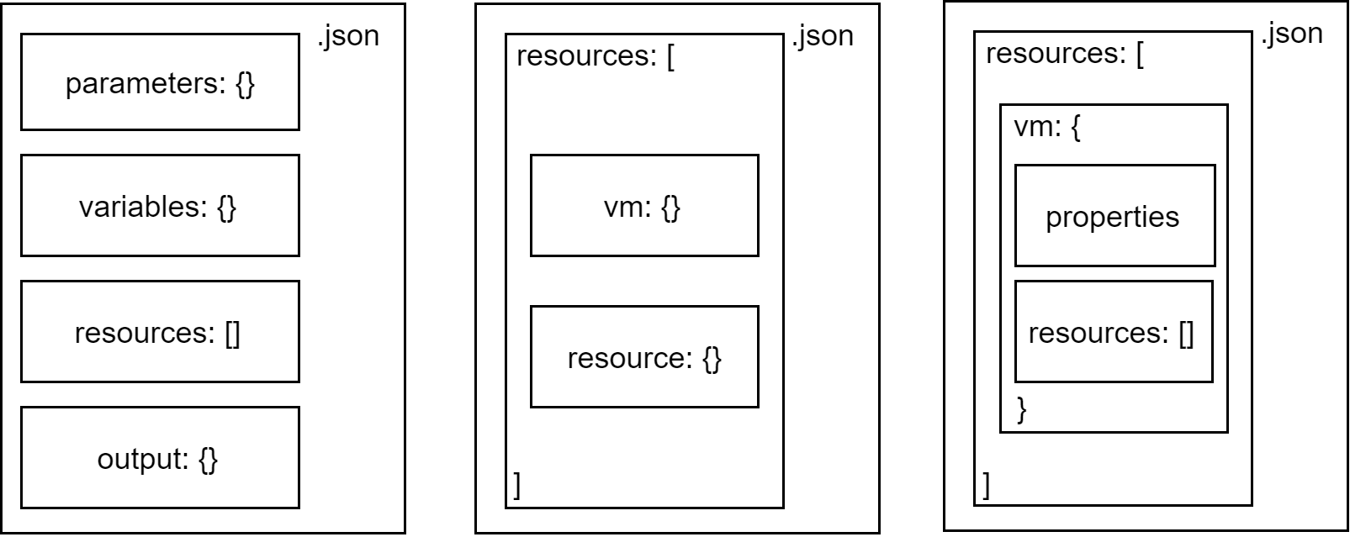

Slide 29
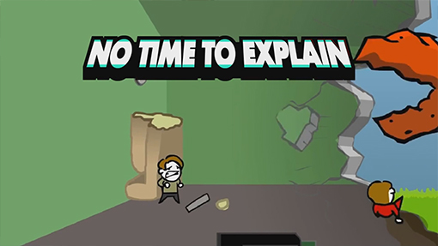

Slide 30
Questions?

